Slide 1
Union of BC Municipalities
UBCM is the collective voice of local governments in BC
Membership: Represents 100% of local governments in BC and 15 First Nations councils.
Advocacy: Policy positions based on resolutions endorsed by membership.
Governance: Board of local government elected officials appointed by members.
Notes:
UBCM is the collective voice of local government in British Columbia.
For more than 120 years, UBCM has brought communities together to advocate for local government priorities, deliver programs, and provide services that help local governments succeed.
Governed by a board of local elected officials chosen by their peers, UBCM's membership includes every local government in British Columbia as well as 15 First Nations councils.

Slide 2
Union of BC Municipalities
ADVOCACY | PROGRAM DELIVERY | MEMBER SERVICES
Common issues Resolutions-based advocacy Direct advocacy with provincial and federal governments | Administers grants for infrastructure, capacity, emergency management and more. $420 million to local governments each year | Annual Convention The Compass Group Benefits Plan Mental health toolkit for elected officials
Notes:
The services UBCM provides fall into three areas: Advocacy, Program Delivery, and Member Services.
Advocacy:
→ Since local governments operate within a legislative framework established by the Province, you need to work together when change is needed.
UBCM provides that forum for local governments to identify shared priorities and advocate collectively to provincial and federal governments.
Resolutions that are brought forward, discussed and endorsed by UBCM members form the basis of UBCM’s policy positions and advocacy priorities.
Program Delivery:
→ UBCM administers federal and provincial funding programs that address a range of local government needs, including capacity building, infrastructure renewal, emergency preparedness, and more.
→ Approximately $420 million is delivered to local governments through UBCM every year
Largest is the Build Communities Strong Fund – Communities Stream alone contributes to over 1,000 infrastructure projects in B.C. annually
(formerly known as the Canada Community-Building Fund, and Gas Tax before that)
Administer with transparency, keeping programs accessible, and with low overhead costs
Member Services
UBCM Convention is the largest political gathering in B.C.
Invaluable opportunities to connect with decision makers, colleagues, experts and provincial officials.
Resolutions endorsed by the membership provide a foundation for UBCM’s policy positions and guide our advocacy priorities.
Group Benefits Plan leverages the buying power of 4,000 employees across 130 different plans.
→Developing a mental health toolkit for local elected officials in response to member needs.
→ Will include online courses, resources and subsidized access to counselling. Full platform will be released in January 2027.

Slide 3

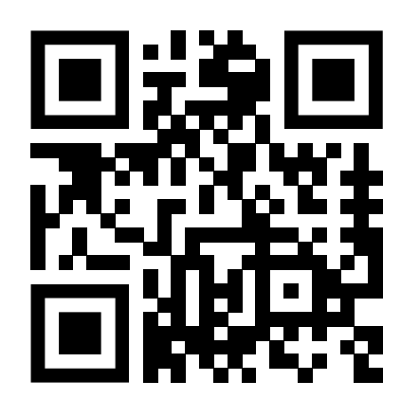
Union of BC Municipalities
Sign up to The Compass to stay informed on UBCM’s advocacy and
weekly updates on:
• Funding intakes
• Opportunities to give feedback
• Events and training
• News relevant for local governments
www.ubcm.ca/thecompass
Notes:
(Please encourage officials to sign up with the QR code. Thank you!)

