Slide 1
Building Social Consensus through Community Assemblies

Slide 2
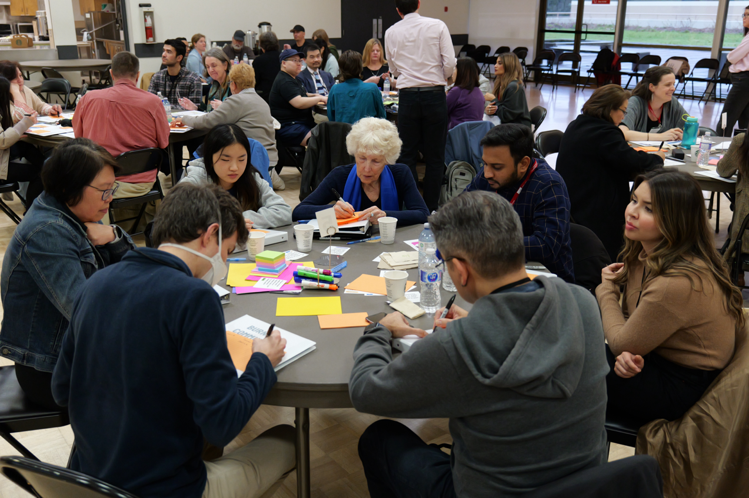

Building Social Consensus through Community Assemblies
Speakers:
Councillor Sav Dhaliwal, City of Burnaby
Dr. Andréanne Doyon, SFU Planning Program
Councillor Susan Kim, City of Victoria
Councillor Nadine Nakagawa, City of New Westminster
UBCM 2025 Convention
Moderated by Robin Prest

Slide 3
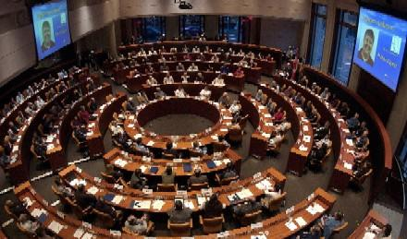
Community Assemblies: Homegrown in BC

Slide 4
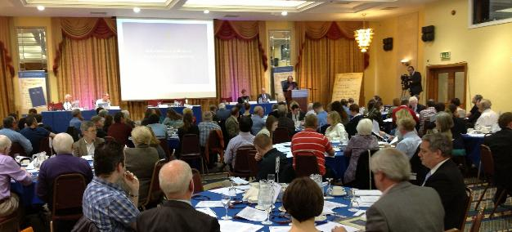
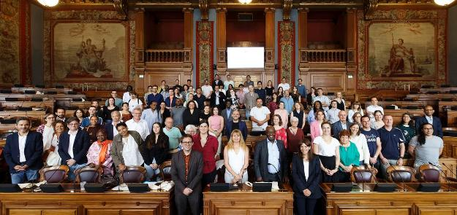
Community Assemblies: Globally Recognized

Slide 5
WHAT IS A COMMUNITY ASSEMBLY?

Slide 6
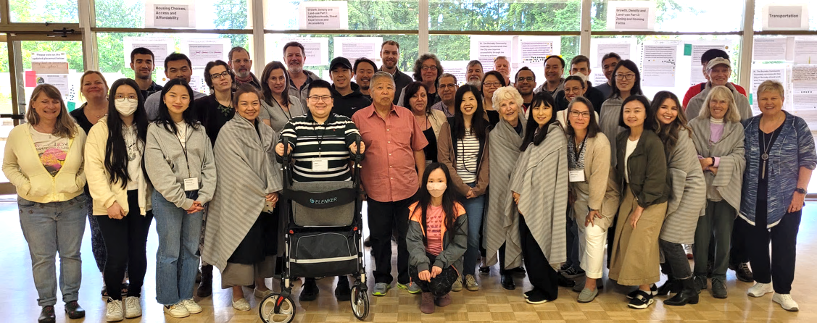
A body of residents selected by civic lottery to broadly reflect the diversity of the community…

Slide 7
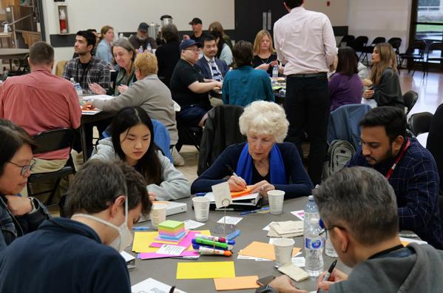
…takes time to learn and explore trade-offs…

Slide 8

…develops actionable recommend-ations that reflect decision-maker constraints…

Slide 9
…where decision-makers agree in advance to accept or respond to the recommendations.

Slide 10
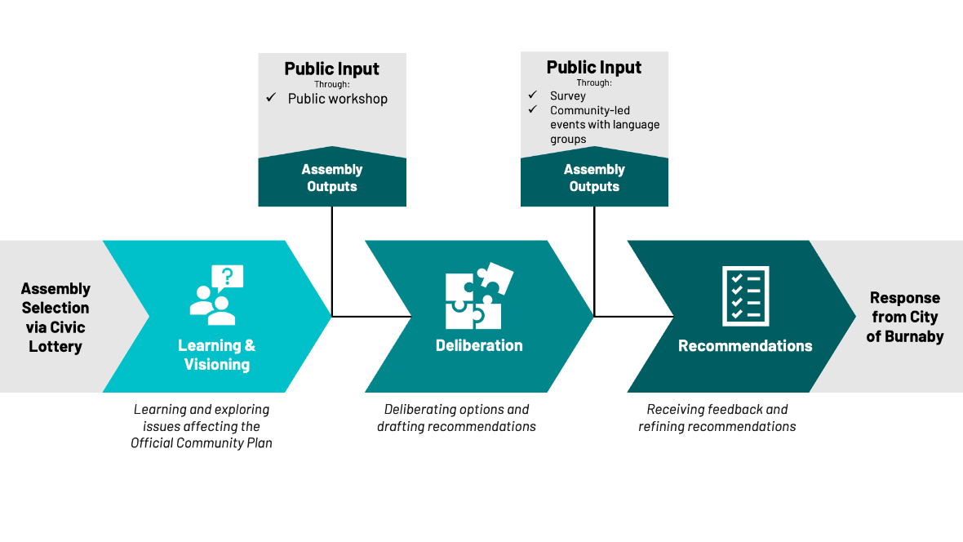
Example Sequencing from Burnaby Community Assembly
Meeting #1
Feb. 24
Meeting #2
Mar. 2
Meeting #3
Mar. 16
Meeting #4
Apr. 20
Meeting #5
May 4
Meeting #7
Jun. 15

Slide 11
WHY CONSIDER AN ASSEMBLY?

Slide 12
Potential Benefits:
Foster public’s informed judgement
Create open discussion about trade-offs and constraints
Model empathy and consensus over polarization and positional stances
Increase legitimacy of difficult decisions

Slide 13
An Assembly is a Bad Idea if:
Multiple viable options don’t exist
Decision-makers don’t commit in advance to act on recommendations
Arm’s length governance not in place to safeguard integrity of process

Slide 14
KEY ROLES

Slide 15
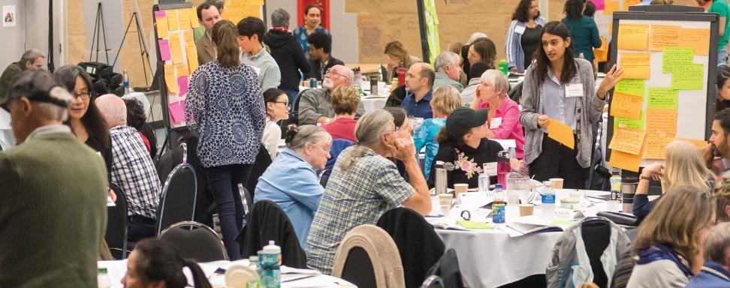
Impartial Convenor & Advisory Committee

Slide 16
Experts and Stakeholders to Inform Learning Materials & Deliberations

Slide 17
Community Groups & Engagement

Slide 18
QUESTIONS & DISCUSSION
Notes:
Session Description: In an era of increased polarization, strained public trust and scarce resources, Community Assemblies offer a powerful engagement tool for complex issues such as housing, land use, transportation and governance. Building upon a recent surge in the use of Assemblies in BC, this session will explore how Assemblies can support the work of local governments by fostering empathy, building consensus and navigating real-world policy constraints. Participants will examine what makes Assemblies stand out from other forms of participation by using civic lotteries to engage the broad diversity of the community, building in time to learn and develop recommendations, and closing the loop so that the community feels heard. Join us for this interactive session and come prepared to discuss how you can apply the Community Assembly model in your context.

