Slide 1
CleanBC Roadmap to 2030
Presenter: Chris Gilmore
Date: April 5, 2022
Notes:
Introduce presenter
Presentation provides an overview of the CleanBC Roadmap to 2030, which is B.C.’s plan to meet our climate targets.

Slide 2
The Original CleanBC Plan
Launched in late 2018 with over 40 initiatives to reduce GHG emissions and move to cleaner energy in transportation, industry, and buildings
Initiatives were projected to achieve ~75% of the 2030 climate target (of reducing emissions by 40% below 2007 levels)
CleanBC committed to a plan to fully achieve the 2030 target
The CleanBC Roadmap to 2030 is that plan – following the actions outlined in the Roadmap will see us reach our legislated 2030 target, and do our part to reach our Paris climate commitments
Notes:
The original CleanBC plan was first launched in December 2018 with over 40 initiatives to reduce GHG across our economy, and focused on the three sectors that have the largest share of emissions: transportation, buildings, and industry.
At the time of its launch, CleanBC initiatives were projected to achieve ~75% of the 2030 climate target of reducing GHG emissions 40% below 2007 levels. CleanBC also committed to further policy development to fully achieve the 2030 target.
The CleanBC Roadmap to 2030 builds on the success of CleanBC, and creates a path to fully achieve the 2030 target.

Slide 3
The Roadmap Approach
Examines the eight key areas (pathways) across B.C.’s economy that generate emissions or can create solutions
Assesses B.C.’s progress in developing and deploying low- and zero-carbon products, approaches and technologies
Sets out a series of pathways to:
drive deployment in areas where clean solutions are already mature, and
support innovation in areas where clean solutions are emerging
This will help deliver more clean solutions, faster
Notes:
The Roadmap outlines eight key areas across B.C.’s economy that either generate GHG emissions, or are areas that could generate climate solutions to reduce emissions or avoid them altogether.
These eight areas are called pathways, and Roadmap initiatives are grouped by these pathways. Each of the pathways has been assessed to determine the maturity of existing solutions and climate policies within the pathway.
In pathways with clean options already readily available – like heat pumps or electric vehicles – the pathway focuses on actions to scale up these solutions.
In pathways where clean options are still emerging – like negative emissions technologies – the pathway focuses on innovation, research and development to determine solutions.
This approach will help to drive more clean solutions, faster.

Slide 4
Roadmap Pathways
Agriculture, Aquaculture
and Fisheries
Negative Emissions Technologies
Forest Bioeconomy
Low Carbon Energy
Transportation
Communities
Buildings
Industry, including Oil & Gas
Notes:
As mentioned in the previous slide, the Roadmap sets out a series of eight pathways to support innovation in sectors where low carbon solutions are emerging, and drive deployment in sectors where they’re already mature. You can see the eight pathways on the slide.
Some markets are more straightforward to transform, whereas others can be more challenging.
The Roadmap shows how B.C. will drive rapid market transformation where we have technological certainty, and catalyze public and private investment in innovative solutions, pilot projects and other early action where we are less sure.

Slide 5
B.C.’s Marquee Measures
A stronger price on carbon pollution with corresponding affordability and competitiveness protection
Accelerated zero emission vehicle law for light-duty and new targets for medium- and heavy-duty vehicles
A commitment to develop a comprehensive Clean Transportation Action Plan
Low Carbon Fuel Standard enhancement and doubling the target for renewable fuels produced in B.C. to 1.3 billion litres by 2030
New GHG cap for natural gas utilities with a variety of pathways to achieve it
Enhance the CleanBC Program for Industry and ensure oil and gas achieves its sectoral target
Near elimination of industrial methane emissions by 2035 and a 75% reduction in oil and gas methane by 2030
New large industrial facilities to work with government to demonstrate how they align with government’s 2030 and 2040 targets and submit plans to achieve net-zero emissions by 2050
Zero carbon new buildings and highest efficiency standards for new space and water heating equipment by 2030
A new program to support local government climate action
Notes:
This is a big plan. It is cross-government and multi-sector. It is founded on and implemented with continuous feedback opportunities to make sure it is and remains responsive - and it builds on the progress since CleanBC launched in 2018.
On the screen are the ‘Marquee Measures’ – these are the actions that drive the most GHG reductions while helping B.C. transition to a cleaner economy.
The ‘marquee measures’ introduced in the roadmap follows advice received from the Climate Solutions Council, which includes representatives from academia, business and industry, Indigenous peoples, local government, labour, youth, and environmental groups. This input has been informed by experience – and the advice from the Council is a result of lively and informed debate to find a consensus perspective.

Slide 6
Policies by Pathways
Notes:
The next several slides will delve into Roadmap policies outlined in each of the eight pathways (including the marquee measures that we just reviewed).

Slide 7
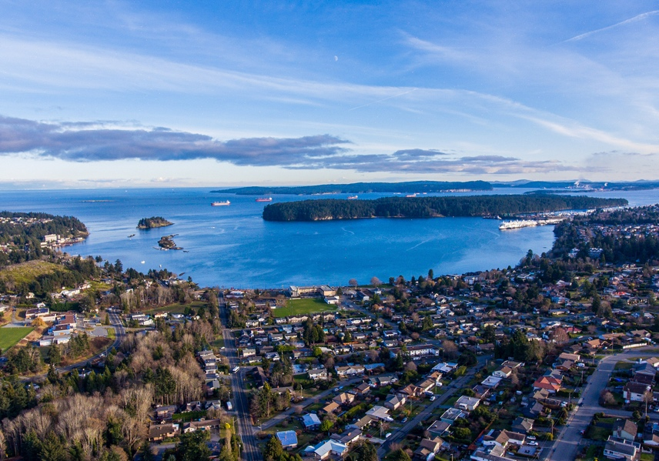
Low Carbon Energy Policy Proposals
Raise Low Carbon Fuel Standard (LCFS) target from 20% using 30% by 2030 as a starting point for analysis/consultation; expand the LCFS to aviation & marine fuels
GHG Reduction Standard with emissions cap set at approximately 6 Mt CO2e per year for 2030 for natural gas utilities aligned with sectoral targets
Includes multiple compliance pathways, including the use of renewable natural gas
Industry and stakeholders to be consulted on details
Implement 100% Clean Electricity Delivery Standard for BC Hydro
Support BC Hydro’s electrification plan by adding electrification/fuel-switching to its mandate, among other initiatives
Implement the hydrogen strategy
Double ‘made-in-BC’ renewable fuel targets to 1.3 billion litres
Notes:
Fossil fuels are a major source of emissions in B.C.
The Roadmap proposes several measures to clean up our energy system, including increasing the renewable content in the gasoline and diesel in our cars and reducing the carbon intensity of the natural gas that heats our homes and businesses.
The Province will implement a 100% Clean Electricity Delivery Standard for BC Hydro to increase the benefit of further electrification and support BC Hydro in phasing out remaining gas-fired facilities on its grid by 2030.
B.C. has a comparative advantage in clean energy, and the Province will leverage that advantage by implementing the BC Hydrogen Strategy.
And B.C. will capitalize on an area that has seen great strides since the launch of CleanBC and double the target for made-in-B.C. renewable fuels to 1.3 billion litres.

Slide 8
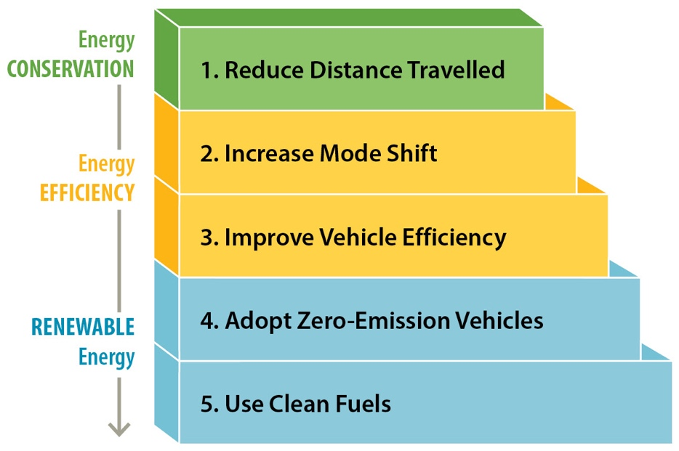
Transportation Policy Proposals
Complete Clean Transportation Action Plan with an 'efficiency first' approach to encourage complete, compact communities that reduce vehicle traffic
Increase light-duty ZEV targets to 26% by 2026, 90% by 2030 and 100% by 2035 (from 2040)
Develop new medium and heavy-duty vehicle ZEV requirements aligned with California
Tailor CleanBC Go Electric Program to better support low and middle-income British Columbians
Develop right to charge legislation
Establish provincial mode share targets for personal travel and continued support for active transportation
Target a 25% reduction in vehicle kms driven by cars by 2030, relative to 2020
Increase trips by walking, cycling, transit to 30% by 2030, 40% by 2040, and 50% by 2050
Establish commercial transport energy/emissions intensity targets to encourage greater mode shifts and drive efficiencies
Electrify public transit and ferry fleets in line with BC Ferries, B.C.’s inland ferries, TransLink and BC Transit goals
Target of 10,000 public EV charging stations by 2030 and ensure by 2024 geographic coverage of fast-charger sites across BC
Notes:
Transportation is the area most people think about when considering their own carbon footprint, and is in fact the sector that accounts for the largest amount of emissions in B.C.
The Roadmap will accelerate B.C.’s targets for zero-emission new vehicle sales, to 90% by 2030 and 100% by 2035. This is a full five years ahead of the CleanBC target.
The Province will also adjust its incentive programs to ensure we are providing support to those that need it most and have clean solutions accessible to more people.
In partnership with industry and other key stakeholders, the Province will work to make commercial transportation systems more competitive while accelerating innovation and driving the adoption of clean B.C. technologies, with a commitment to reducing the energy intensity of goods movements by 10% in 2030, 30% by 2040 and 50% by 2050.
And, the Province will accelerate the deployment of charging stations across B.C.

Slide 9
Buildings & Communities Policy Proposals
Buildings
Decarbonize new construction through carbon pollution standards in the BC Building Code by 2030
Reduce emissions in existing homes and buildings through highest efficiency standards for new space and water heating equipment by 2030
Modify energy efficiency programs so they enhance building envelope incentives and no longer incent conventional gas-fired heating equipment
Develop strategy to minimize embodied carbon in materials and support adoption of low carbon building materials
Ensure incentive programs benefit those with the greatest need/lowest incomes
Proceed with next steps on a Property Assessed Clean Energy (PACE) program
Communities
Develop a new program with predictable funding to support local government climate action/resiliency
Review of legislation to enable/support/require action on climate action goals
Build awareness of programs for Indigenous communities, continue capacity-building, streamlining of application processes, and advocacy with federal government for supports
Focus on complete and compact communities to align with Integrated Planning Approach and the Homes for B.C. housing plan
Notes:
The Roadmap also proposes several measures to reduce emissions in our buildings and in our communities.
B.C. will bring carbon pollution standards into the BC Building Code which creates consistency across the province.
Incentives currently offered for fossil fuel furnaces and hot water tanks will be discontinued, so we stop encouraging the purchase of new equipment that will be ‘locked in’ for years.
And, the Province will continue with the next steps on a Property Assessed Clean Energy program – or PACE – to remove the barrier of high up-front costs for people and businesses who want to upgrade their homes.
There will be a suite of measures to support communities too, including a new program for local governments to support their capacity to tackle climate change.

Slide 10
Industry/Oil & Gas Policy Proposals
Industry
Eliminate industrial sources of methane (e.g. from oil and gas, mining, forestry and landfills) as much and as quickly as possible, before 2035
Provincial approach to carbon capture, utilization and storage (CCUS) to explore suitable storage locations, support B.C. clean tech companies, and help industry transition to net zero
New large industrial facilities to work with government to demonstrate how they align with government’s 2030 and 2040 targets and submit plans to achieve net-zero emissions by 2050
Enhance the CleanBC Program for Industry to reduce emissions in line with our sectoral targets while supporting competitiveness
Oil and Gas - subject to the Industry measures, plus
Set policy framework to achieve sector emissions target
Target a 75% reduction in methane emissions by 2030 (below 2014 levels) for oil and gas sector, in line with federal requirements
Royalty Review includes consideration of climate goals in analysis with results to come in February 2022
Commit to cleaning up 100% of current orphan wells in BC before 2030 through the industry-funded Orphan Site Remediation Fund
Notes:
Reducing emissions from B.C.’s industrial sectors is critical, and it can come with enormous economic upside.
On industry generally, B.C. will look to virtually eliminate methane emissions by 2035. At the same time, the Province will develop a provincial approach to carbon capture and storage, require companies to show plans for how they will reach net zero by 2050 and enhance the industrial climate program – to further support emissions reductions and economic competitiveness – for 2023.
This last part is critical so B.C. can maintain and strengthen its resource economy, which in several sectors is ideally positioned to provide the resources a global low carbon economy needs.
The oil and gas sector is a major source of emissions in B.C. and this plan will do more, including reducing emissions from the sector and requiring a 75% reduction in methane emissions by 2030.
As part of the Roadmap, the Province will review the rules for oil and gas royalties to ensure they support provincial goals for economic development and environmental protection. B.C. will reduce emissions from oil and gas by 33-38% by 2030, compared to 2007 levels.

Slide 11
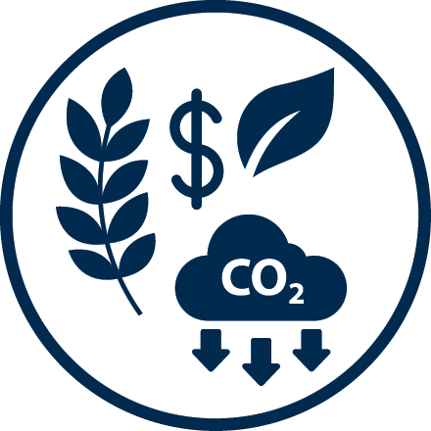
Sequestration Policy Proposals
Forest and Agriculture Bioeconomy
Finalize the forest carbon offset protocol to increase the creation of forest offsets
Near elimination of slash pile burning by 2030
Grow our carbon sinks through investments in reforestation and the federal 2 Billion Trees commitment
Evaluate additional reforestation and forest management activities in forest health and foster climate resilient forests (e.g., fertilization, forest health, wildfire prevention)
Align activities with Old Growth Strategic Review implementation
Support investment in the production of bioproducts and bioenergy opportunities
Encourage regenerative agricultural, AgriTech and carbon sequestration practices on agricultural land
Support increased on-farm efficiencies and fuel switching, and anaerobic digesters for biogas production
Negative Emission Technologies (e.g. direct air carbon capture)
Part of overall strategy to meet legislated targets and commitment to net zero by 2050
Support development of clear and consistent definitions of NET accounting standards for high quality offset credits and determine how they are accounted for in provincial and national inventories
Notes:
The final section of the Roadmap relates to carbon sequestration.
B.C.’s forests and ecosystems can play a major role in our fight against climate change. The Province will look to plant more trees and finalize the forest carbon offset protocol.
The Province will also seek to nearly eliminate forest slash pile burning by 2030, while supporting GHG efficient practices in the agriculture, aquaculture and fisheries sector.
And, we will facilitate the development of new ‘negative emissions technologies’ too – the international community is increasingly seeing a credible and vital role for technologies that remove carbon from the air, and B.C. can play an outsized role in this emerging sector.

Slide 12
Roadmap Reductions/ Reaching the 2030 target
By using all pathways together, the Roadmap allows B.C. to meet the legislated 2030 target
Sequestration policies provide real further reductions but are not included in reductions to reach the 2030 target
Notes:
This slide shows how B.C.’s target will be met:
The top bar is business as usual without CleanBC Phase 1 actions
The second shaded area shows the reductions expected from CleanBC Phase 1 actions
And the last shaded area shows the reductions expected from the CleanBC Roadmap
The graph is a good reference – a visual representation of current forecasting.
This is a good opportunity to re-emphasize the importance of the CleanBC accountability provisions – including the commitment by law to table our Annual Accountability report – setting out the measures – our progress – and future action, and the pivotal role of the Climate Solutions Council.
Climate action requires constant attention. It requires robust feedback loops to monitor, measure and adjust to conditions (often conditions outside our direct control). Continued collaboration from all sectors will factor significantly in bending the emissions curve.
The modelled actions across all pathways within the Roadmap to date show that the legislated 2030 emission reduction target will be met.
Having a credible, realistic path to achieving the 2030 target is an enormous accomplishment – especially here in B.C. where our electrical grid is already 98% clean. Most jurisdictions to date have focused on cleaning their electrical grid to achieve emissions reductions. Because B.C. has the advantage of a clean grid, we need to dig deeper and broader to achieve those same reductions. And we’ve done that in the Roadmap.

Slide 13
Reconciliation
DRIPA Action Plan:
a province-wide, whole-of-government pathway for our journey toward reconciliation
Roadmap developed alongside Indigenous engagements; policies designed to support reconciliation outcomes
As the action plan is implemented and Roadmap policies roll out there are opportunities to build stronger partnerships with Indigenous peoples, improve how decision-making is shared, and better incorporate Indigenous perspectives and interests into provincial climate mitigation and adaptation plans and policies
Examples:
Interest in decarbonizing buildings and transportation options in Nations
Develop new revenue options from bioeconomy and offsets
Increase Indigenous workforce involvement in building enhancement and decarbonization (remote community energy/energy coach programs); ZEV sector (including charging/hydrogen fueling stations); negative emissions technology/ CCUS
Capacity support for Indigenous innovation in industrial decarbonization and low carbon industrial growth, and climate engagement
Desire for skills training to pursue new low carbon economic opportunities
Forthcoming Indigenous Clean Energy Opportunities Review
Existing Renewable Energy for Remote Communities Strategy
Notes:
The Province has done comprehensive engagement with Indigenous peoples during the development of the Roadmap, and the policies within the Roadmap are designed to support reconciliation and reduce emissions. These are based on stronger partnerships with Indigenous peoples, with a focus on shared decision making and ensuring Indigenous knowledge and perspectives are incorporated into climate plans and policies.
In summer 2021, the Province held multiple full-day sessions with Indigenous communities, leaders, and organizations to inform the development of the Roadmap.
Some examples of what was heard are in the yellow section of the slide, and the Roadmap document itself provides more detail on how Indigenous feedback has directly influenced the policies in the Roadmap.
Some of what was heard from Indigenous peoples included:
The need for greater affordability and accessibility of CleanBC programs, which led to the commitment of a single-window access for all CleanBC programs, and a renewed focus on affordability in program design.
The critical role of public climate education as a key to support community decision making, and this influenced the Roadmap commitment to implementing a public awareness and education campaign with a dedicated strategy to connect with youth.
The desire for skills training to ensure participation in clean growth opportunities.

Slide 14
Climate Commitments for Local Governments
2020 – Recommendations from the UBCM Special Committee on Climate Action, with signature initiatives and supporting actions identified across seven areas
2021 – $11M for new Planning and Land Use for Climate Action program
2022 – Roadmap commits to a new program with predictable funding to support local government climate action/resiliency
2022 – Roadmap commits to a review of legislation to enable/support/require action on climate action goals
2022 – Renewed Green Communities Committee to continue regular collaboration with UBCM members
2022 - CleanBC Communities Fund opens third funding call to distribute $133M in funding for climate infrastructure
Notes:
There has been several significant developments to support local government climate action over the last two years.
In November 2020, the UBCM’s Special Committee on Climate Action released its recommendations to the Province, focusing on signature initiatives and supporting actions across several areas like buildings, transportation, waste, and land use.
In Budget 2021, the Province committed to $11M of funding for a new program through Ministry of Municipal Affairs for planning and land use to support climate action.
The CleanBC Roadmap to 2030 committed to a new program that provides predictable funding to local government to support their climate action – both in terms of reducing emissions and in preparing their jurisdictions for the impacts of climate change.
In 2022, the Province renewed its Green Communities Committee, made up of executives from ENV-CAS, MUNI and UBCM and that meets regularly to ensure that UBCM members – both rural and urban – are updated on CleanBC Roadmap objectives and investments.
Finally, in 2022, the Province announced its third round of funding for the CleanBC Communities Fund to support climate infrastructure projects for local governments and Indigenous communities.

Slide 15
Highlights of Roadmap Funding in Budget 2022
Budget 2022 provides over $1 billion in new funding for climate initiatives, which builds on previous funding of $2.3 billion since the inception of CleanBC, including:
$76M for the new program to support local government climate action
$30M of funding to local government for active transportation
Continued funding for building retrofit rebates through Better Homes and Better Buildings programs
Continued funding for electric vehicle rebates
PST exemption on heat pumps and used electric vehicles
$13M to develop a Circular Economy Strategy
$1.5 billion for emergency management and to support communities with disaster recovery costs
$210M to support community climate-change preparedness and emergency management
Notes:
Budget 2022 provides significant new funding for climate action across several sectors in B.C.
New funding announcements within the budget that relate to local government are as follows:
$76M of funding for the new local government climate action program
$30M of funding for local government to support active transportation
Continued funding for Go Electric rebates for electric vehicles, and building retrofits rebates through the Better Homes and Better Buildings programs
PST exemption on heat pumps and used Evs
Funding to develop a circular economy strategy
Significant funding to support emergency management, disaster recovery costs for communities and to support communities in climate change preparedness and emergency management.

Slide 16
Roadmap to 2030 Greenhouse Gas Reductions by Initiative
Economy-Wide Initiatives
Increase the price of carbon pollution | Meet or exceed the federal benchmark of $170 by 2030
 | Revise industrial carbon pricing in 2023
Reduction of GHGs in 2030 for Economy-Wide Initiatives | Subtotal 2.4
Low Carbon Energy
Enhance the Low Carbon Fuel Standard | Increase the carbon intensity reduction requirement
 | Expand to include marine and aviation fuel
 | Double production capacity for made-in-B.C. renewable fuels to 1.3bn litres
Increase benefits of electrification | Implement 100% Clean Electricity Delivery Standard
Reduce emissions from natural gas | New GHG cap for natural gas utilities with a variety of compliance options
Reduction of GHGs in 2030 for Low Carbon Energy | Subtotal 5.0
Transportation
Accelerate zero-emission vehicle (ZEV) law | By 2030, ZEVs will account for 90% of all new light-duty vehicle sales in the province
 | New ZEV targets for medium- and heavy-duty vehicles to be developed in alignment with California
Reduce light-duty vehicle travel | Reduce distances travelled by vehicle by 25% relative to 2020
 | Encourage increase in mode shift to walking, cycling and transit to 30% by 2030
Reduce goods movement emissions | Reduce the energy intensity of goods movement by 10% relative to 2020
Reduction of GHGs in 2030 for Transportation | Subtotal 4.9
Notes:
This slide and the next provides a list of initiatives within the Roadmap, and the expected emissions reductions expected from each pathway as a result.
You can find this table at the back of the Roadmap, and it demonstrates how – collectively – the Roadmap will see us reaching our 2030 target.

Slide 17
Buildings
New carbon pollution standard in BC Building Code | Carbon pollution standards introduced for new buildings in 2024, with zero-carbon new construction by 2030
Highest efficiency standards | After 2030, all new space and water heating equipment sold and installed in B.C. will be at least 100% efficient (i.e. electric resistance heating, heat pumps, and hybrid electric heat pump-gas systems)
Reduction of GHGs in 2030 for Buildings | Subtotal 1.3
Industry
Enhance CleanBC Program for Industry | Enhance industry program to reduce GHGs and support a strong economy
Reduce methane emissions | Near elimination of methane emissions by 2035 in oil and gas, mining, industrial wood waste and other sectors
Make new industrial operations ‘net-zero ready’ | New large industrial development to submit plans to achieve net-zero emissions by 2050 and show how they align with interim 2030 and 2040 targets
Reduce oil and gas sector emissions | Implement programs and policies so that oil and gas emissions are reduced in line with sectoral targets (reduction of 33-38% by 2030)
Reduction of GHGs in 2030 for Industry | Subtotal 2.6
Other Measures Including: reducing agricultural emissions, supporting compact and resilient communities, and aligning with federal, municipal and Crown Corporation plans. | Increase the carbon intensity reduction requirement
Reduction of GHGs in 2030 for Other Measures | Subtotal 0.9
Note: Individual pathway reductions do not add up to the totals because of interaction effects between policies that target the same emissions
Roadmap to 2030 | 16.2 MtCO₂e
CleanBC Phase 1 | 10.5 MtCO₂e
Total GHG MtCO₂e reduced by 2030 | 26.7 MtCO₂e
The legislated target for 2030 is 39.4 MtCO₂e (or a reduction of 26.3 MtCO₂e from a 2007 baseline), which we are exceeding by 0.4 MtCO₂e.

Slide 18
Questions?
Notes:
That brings the presentation to a close. I’d be happy to take questions at this point.

Slide 19
Thank you for joining us.
cleanbc.gov.bc.ca

